Slide 1
March 6th, 2022
James 2
Faith & Deeds

Slide 2
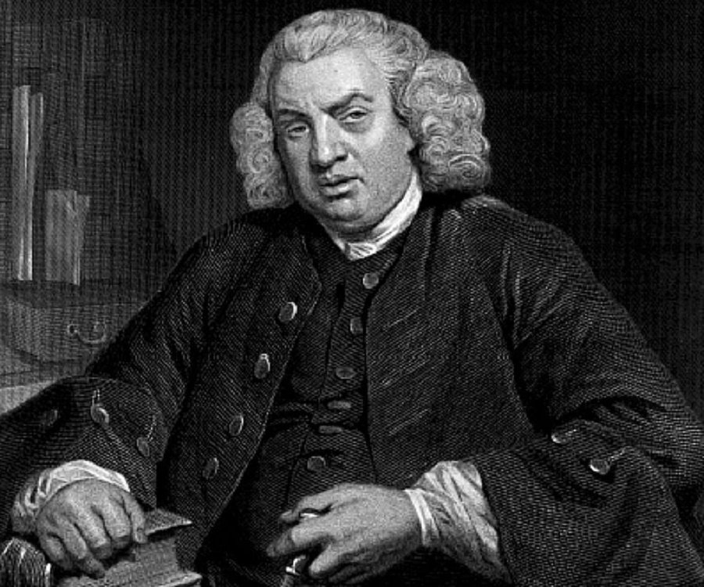
“The true measure of a man is how he treats someone who can do him absolutely no good.” Samuel Johnson

Slide 3
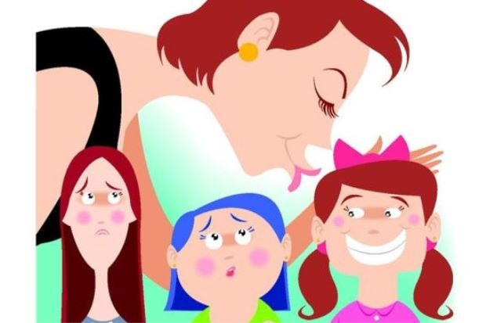

Slide 4
1: AS BELIEVERS, SHOWING PARTIALITY (FAVOURITISM) IS TO MAKE YOURSELF A JUDGE.
James 1:26 Those who consider themselves religious and yet do not keep a tight rein on their tongues deceive themselves, and their religion is worthless. 27 Religion that God our Father accepts as pure and faultless is this: to look after orphans and widows in their distress and to keep oneself from being polluted by the world. James 2:1-4 My brothers and sisters, believers in our glorious Lord Jesus Christ must not show favouritism. 2 Suppose a man comes into your meeting wearing a gold ring and fine clothes, and a poor man in filthy old clothes also comes in. 3 If you show special attention to the man wearing fine clothes and say, “Here’s a good seat for you,” but say to the poor man, “You stand there” or “Sit on the floor by my feet,” 4 have you not discriminated among yourselves and become judges with evil thoughts?

Slide 5
1: AS BELIEVERS, SHOWING PARTIALITY (FAVOURITISM) IS TO MAKE YOURSELF A JUDGE.
1 Samuel 16:7 But the Lord said to Samuel, “Do not consider his appearance or his height, for I have rejected him. The Lord does not look at the things people look at. People look at the outward appearance, but the Lord looks at the heart.”
Leviticus 19:15 Do not pervert justice; do not show partiality to the poor or favoritism to the great, but judge your neighbor fairly.
Acts 10:34 Then Peter began to speak: “I now realize how true it is that God does not show favoritism

Slide 6
2: AS BELIEVERS, SHOWING FAVOURITISM IS NOT IN KEEPING WITH OUR CALLING
James 2:5-7 Listen, my dear brothers and sisters: Has not God chosen those who are poor in the eyes of the world to be rich in faith and to inherit the kingdom he promised those who love him?
6 But you have dishonored the poor. Is it not the rich who are exploiting you? Are they not the ones who are dragging you into court? 7 Are they not the ones who are blaspheming the noble name of him to whom you belong?

Slide 7
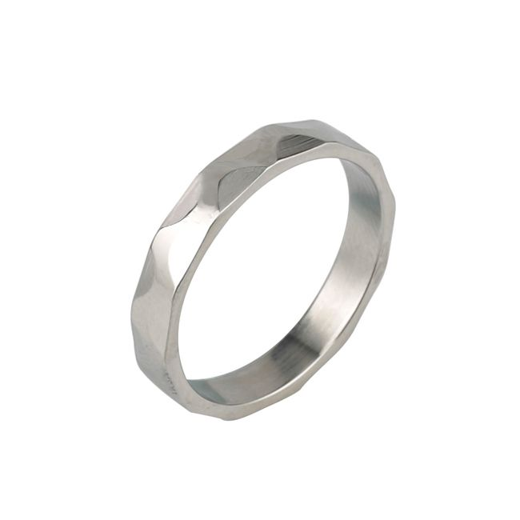
2: AS BELIEVERS, SHOWING FAVOURITISM IS NOT IN KEEPING WITH OUR CALLING
Ephesians 4:1-6 As a prisoner for the Lord, then, I urge you to live a life worthy of the calling you have received. 2 Be completely humble and gentle; be patient, bearing with one another in love. 3 Make every effort to keep the unity of the Spirit through the bond of peace.
4 There is one body and one Spirit, just as you were called to one hope when you were called; 5 one Lord, one faith, one baptism; 6 one God and Father of all, who is over all and through all and in all.

Slide 8
3: AS BELIEVERS, YOU VIOLATE THE OLD AND NEW LAW WHEN YOU SHOW FAVOURITISM
James 2:8-13 If you really keep the royal law found in Scripture, “Love your neighbour as yourself,” you are doing right. 9 But if you show favouritism, you sin and are convicted by the law as lawbreakers. 10 For whoever keeps the whole law and yet stumbles at just one point is guilty of breaking all of it. 11 For he who said, “You shall not commit adultery,” also said, “You shall not murder.” If you do not commit adultery but do commit murder, you have become a lawbreaker.
12 Speak and act as those who are going to be judged by the law that gives freedom, 13 because judgment without mercy will be shown to anyone who has not been merciful. Mercy triumphs over judgment.

Slide 9
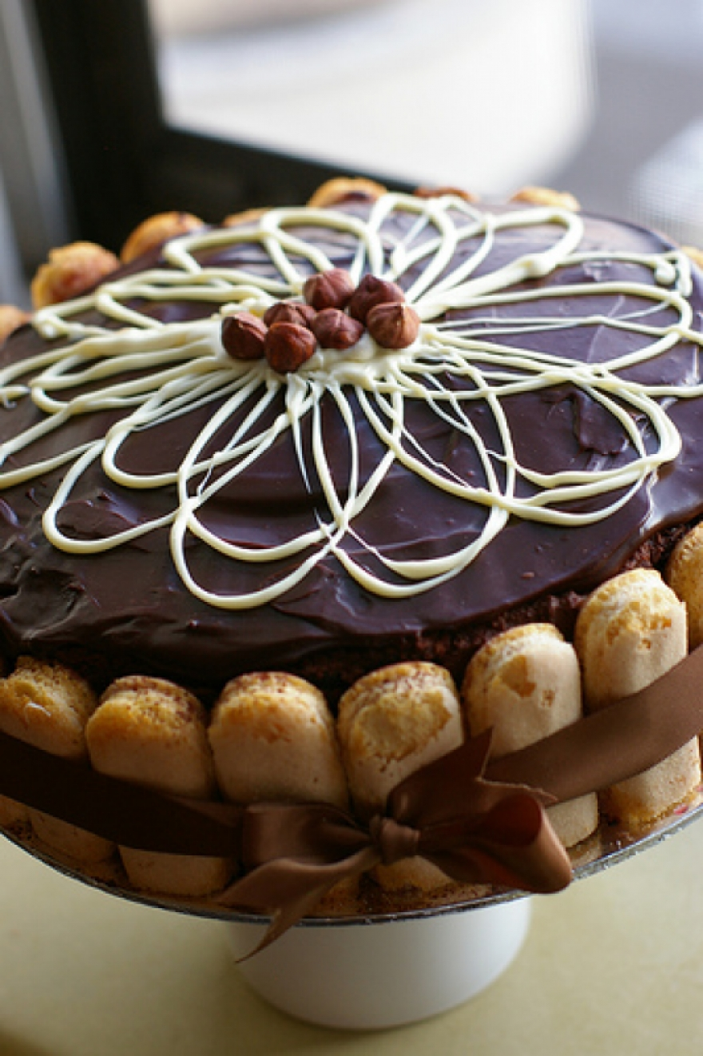
3: AS BELIEVERS, YOU VIOLATE THE OLD AND NEW LAW WHEN YOU SHOW FAVOURITISM
Luke 6:38 “For with the measure you use, it will be measured to you.”

Slide 10
4: GENUINE SAVING FAITH (or is talk cheap?)
James 2:14-19 What good is it, my brothers and sisters, if someone claims to have faith but has no deeds? Can such faith save them? 15 Suppose a brother or a sister is without clothes and daily food. 16 If one of you says to them, “Go in peace; keep warm and well fed,” but does nothing about their physical needs, what good is it? 17 In the same way, faith by itself, if it is not accompanied by action, is dead.
18 But someone will say, “You have faith; I have deeds.”
Show me your faith without deeds, and I will show you my faith by my deeds. 19 You believe that there is one God. Good! Even the demons believe that—and shudder.

Slide 11
4: GENUINE SAVING FAITH (or is talk cheap?)
James 2:20-26 You foolish person, do you want evidence that faith without deeds is useless? 21 Was not our father Abraham considered righteous for what he did when he offered his son Isaac on the altar? 22 You see that his faith and his actions were working together, and his faith was made complete by what he did. 23 And the scripture was fulfilled that says, “Abraham believed God, and it was credited to him as righteousness,” and he was called God’s friend. 24 You see that a person is considered righteous by what they do and not by faith alone.
25 In the same way, was not even Rahab the prostitute considered righteous for what she did when she gave lodging to the spies and sent them off in a different direction? 26 As the body without the spirit is dead, so faith without deeds is dead.

Slide 12
4: GENUINE SAVING FAITH (or is talk cheap?)
….. “the presence of good deeds can not be used to argue the presence of faith, however the absence of good deeds can be used to argue the absence of faith.” ……

Slide 13
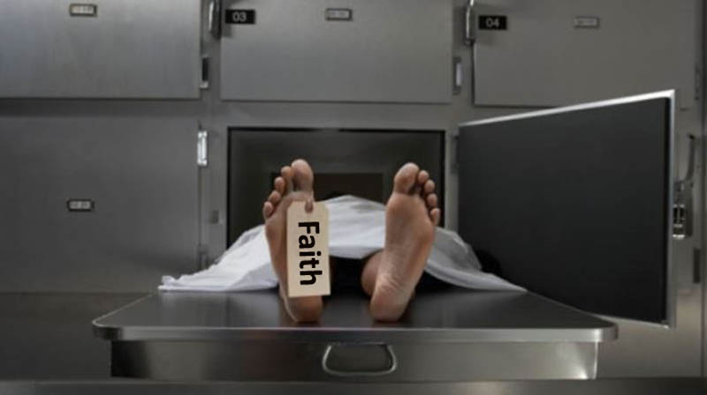
4: GENUINE SAVING FAITH (or is talk cheap?)
4.a A DEAD FAITH (see James 2:14-17,20,26)
❏ A DEAD FAITH will substitute words instead of actions
❏ A DEAD FAITH may use correct words + Sound Doctrine
❏ A DEAD FAITH’S “Walk” does not match their “Talk”
❏ A DEAD FAITH is only intellectual
❏ A DEAD FAITH cannot save anyone!

Slide 14
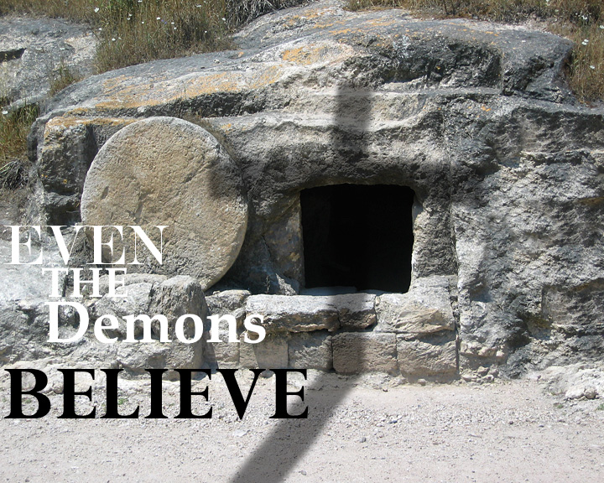
4: GENUINE SAVING FAITH (or is talk cheap?)
4.b A DEMONIC FAITH (see James 2:18 & 19)
❏ A DEMONIC FAITH – no agnostics or atheists here!
❏ A DEMONIC FAITH believes in deity of Jesus (Mark 3:11)
❏ A DEMONIC FAITH believes in Hell (Luke 8:31)
❏ A DEMONIC FAITH believes in a coming Judgement (Mt 8:29)
❏ A DEMONIC FAITH may have an emotional response to the Gospel

Slide 15
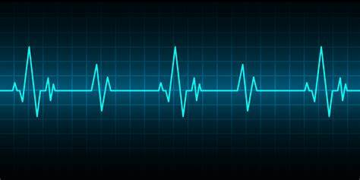
4: GENUINE SAVING FAITH (or is talk cheap?)
4.c A LIVING FAITH (see James 2:20 - 26)
Hebrews 10:38 And, “But my righteous one will live by faith. And I take no pleasure in the one who shrinks back.” 39 But we do not belong to those who shrink back and are destroyed, but to those who have faith and are saved. Hebrews 11:1 Now faith is confidence in what we hope for and assurance about what we do not see. 2 This is what the ancients were commended for.

Slide 16
4: GENUINE SAVING FAITH (or is talk cheap?)
4.c A LIVING FAITH (see James 2:20 - 26)
❏ A LIVING FAITH is based on the
Word of God (Romans 10:17)
❏ A LIVING FAITH cannot be separated from good deeds (which are an evidence that we are accepted by God).
❏ A LIVING FAITH involves the entire person:
- the Mind understands the Truth,
the Emotions (the heart) desires and rejoices in the Truth
the Will acts upon the Truth

Slide 17
4: GENUINE SAVING FAITH (or is talk cheap?)
4.c A LIVING FAITH (see James 2:20 - 26)
Ephesians 2:8-10 For it is by grace you have been saved, through faith—and this is not from yourselves, it is the gift of God— 9 not by works, so that no one can boast. 10 For we are God’s handiwork, created in Christ Jesus to do good works, which God prepared in advance for us to do.

Slide 18
Saved to Serve ….

