Slide 1
April 24, 2022
Genesis 1:3 - Genesis 2:7
Creation & Rest ...

Slide 2
“The only man who never makes mistakes is the man who never does anything.“ Theodore Roosevelt
Matthew 19:4 “Haven’t you read,” he replied, “that at the beginning the Creator ‘made them male and female.”
Mark 13:19: “because those will be days of distress unequaled from the beginning, when God created the world, until now—and never to be equaled again.”

Slide 3
Hebrews 1:1 In the past God spoke to our ancestors through the prophets at many times and in various ways, 2 but in these last days he has spoken to us by his Son, whom he appointed heir of all things, and through whom also he made the universe.
John 1:1 In the beginning was the Word, and the Word was with God, and the Word was God. 2 He was with God in the beginning. 3 Through him all things were made; without him nothing was made that has been made. 4 In him was life, and that life was the light of all mankind. 5 The light shines in the darkness, and the darkness has not overcome it.

Slide 4
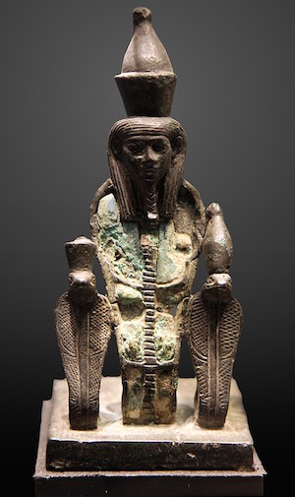
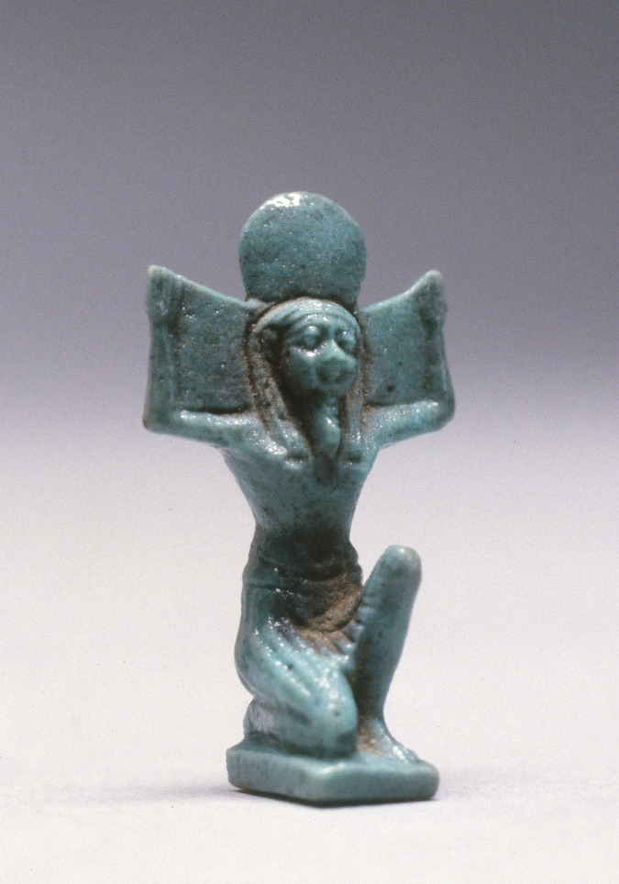
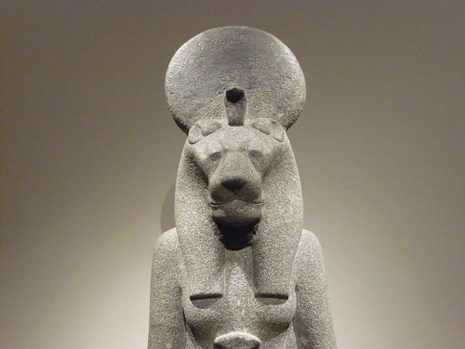
Acts 7:20 “At that time Moses was born, and he was no ordinary child. For three months he was cared for by his family. 21 When he was placed outside, Pharaoh’s daughter took him and brought him up as her own son. 22 Moses was educated in all the wisdom of the Egyptians and was powerful in speech and action.
Atum
Shu
Tefnut

Slide 5
Hebrews 11:1 Now faith is confidence in what we hope for and assurance about what we do not see. 2 This is what the ancients were commended for. 3 By faith we understand that the universe was formed at God’s command, so that what is seen was not made out of what was visible.

Slide 6
DAY #1 - GOD DISPELS DARKNESS
GENESIS 1:3-5
3 And God said, “Let there be light,” and there was light. 4 God saw that the light was good, and he separated the light from the darkness. 5 God called the light “day,” and the darkness he called “night.” And there was evening, and there was morning—the first day.

Slide 7
Revelation 21:23 The city does not need the sun or the moon to shine on it, for the glory of God gives it light, and the Lamb is its lamp. 24 The nations will walk by its light, and the kings of the earth will bring their splendour into it.
2 Corinthians 4:6 For God, who said, “Let light shine out of darkness,” made His light shine in our hearts to give us the light of the knowledge of God’s glory displayed in the face of Christ.

Slide 8
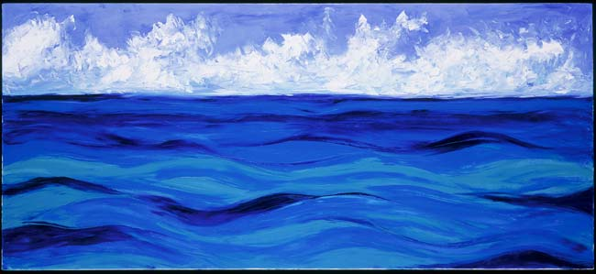
DAY #2 - GOD DISPELS DISORDER
GENESIS 1:6-8
6 And God said, “Let there be a vault between the waters to separate water from water.” 7 So God made the vault and separated the water under the vault from the water above it. And it was so. 8 God called the vault “sky.” And there was evening, and there was morning—the second day.

Slide 9
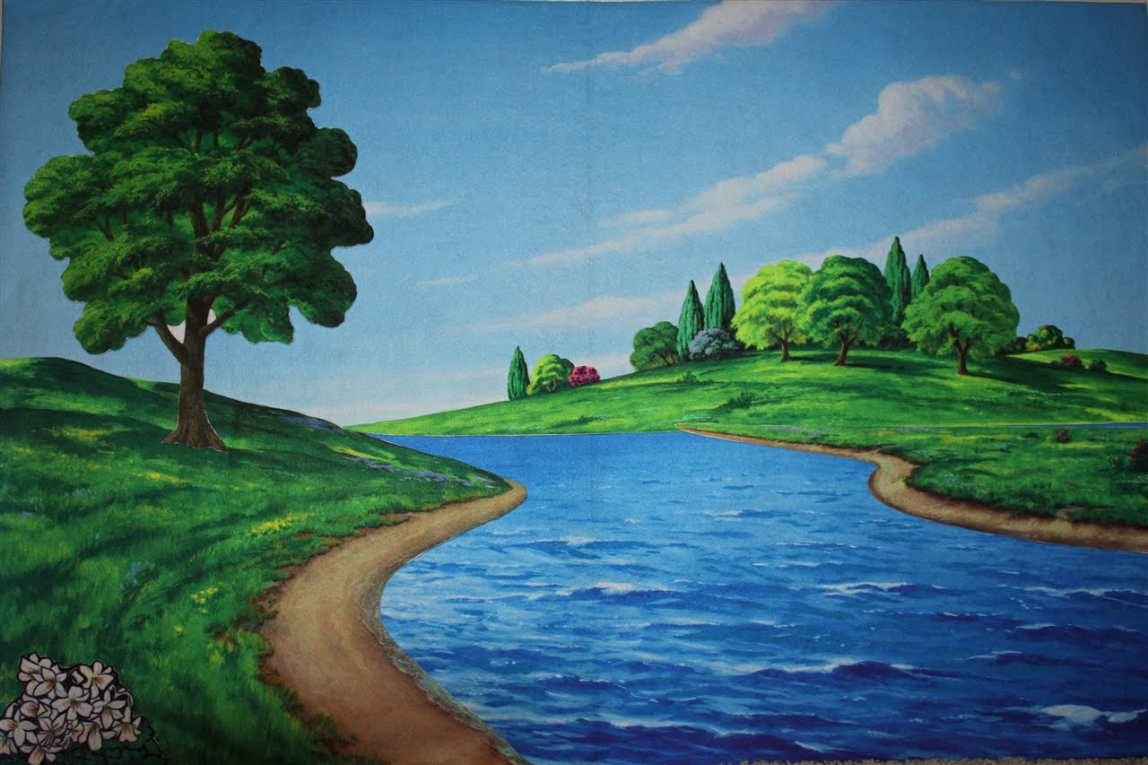
DAY #3 - GOD DISPELS DEADNESS
GENESIS 1:9-13
9 And God said, “Let the water under the sky be gathered to one place, and let dry ground appear.” And it was so. 10 God called the dry ground “land,” and the gathered waters he called “seas.” And God saw that it was good.
11 Then God said, “Let the land produce vegetation: seed-bearing plants and trees on the land that bear fruit with seed in it, according to their various kinds.” And it was so.

Slide 10
DAY #3 - GOD DISPELS DEADNESS
GENESIS 1:9-13
12 The land produced vegetation: plants bearing seed according to their kinds and trees bearing fruit with seed in it according to their kinds. And God saw that it was good. 13 And there was evening, and there was morning—the third day.

Slide 11
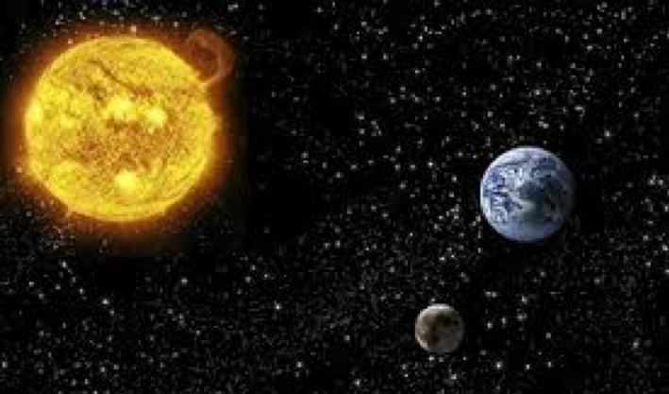
DAY #4 – THE UNIVERSE
GENESIS 1:14-19
14 And God said, “Let there be lights in the vault of the sky to separate the day from the night, and let them serve as signs to mark sacred times, and days and years, 15 and let them be lights in the vault of the sky to give light on the earth.” And it was so. 16 God made two great lights—the greater light to govern the day and the lesser light to govern the night. He also made the stars.

Slide 12
DAY #4 – THE UNIVERSE
GENESIS 1:14-19
17 God set them in the vault of the sky to give light on the earth, 18 to govern the day and the night, and to separate light from darkness. And God saw that it was good. 19 And there was evening, and there was morning—the fourth day.

Slide 13
Psalm 19:
1 The heavens declare the glory of God; the skies proclaim the work of his hands.
2 Day after day they pour forth speech; night after night they reveal knowledge.
3 They have no speech, they use no words; no sound is heard from them.
4 Yet their voice goes out into all the earth, their words to the ends of the world.
“God cares more about souls than stars”

Slide 14
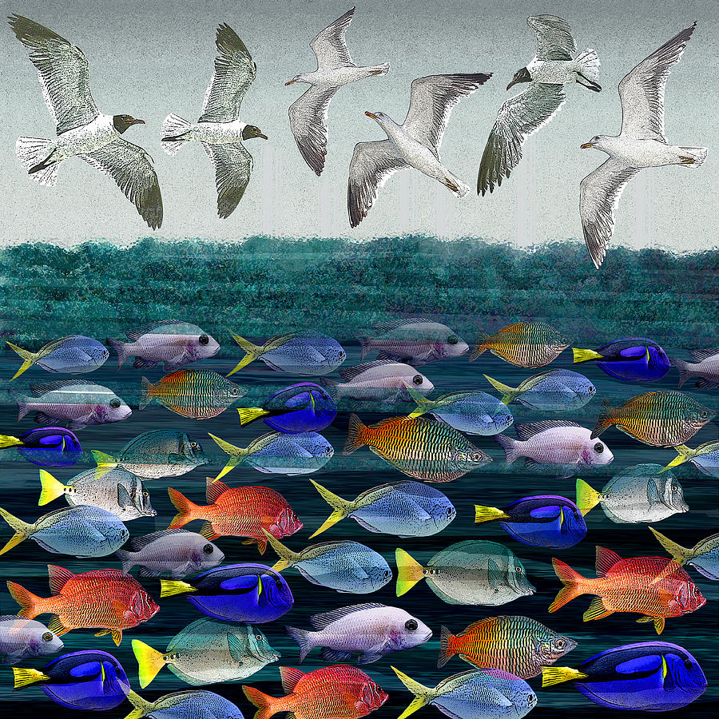
DAY #5 – FISH & FOWL
GENESIS 1:20-23
20 And God said, “Let the water teem with living creatures, and let birds fly above the earth across the vault of the sky.” 21 So God created the great creatures of the sea and every living thing with which the water teems and that moves about in it, according to their kinds, and every winged bird according to its kind. And God saw that it was good

Slide 15
DAY #5 – FISH & FOWL
GENESIS 1:20-23
22 God blessed them and said, “Be fruitful and increase in number and fill the water in the seas, and let the birds increase on the earth.” 23 And there was evening, and there was morning—the fifth day.

Slide 16
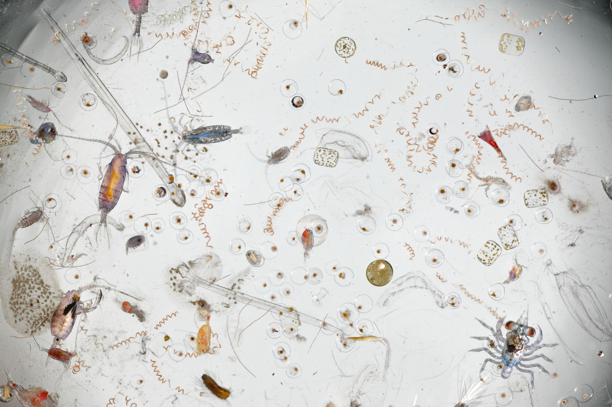
”There is no such thing as bigness or smallness to a God who is infinite” ……. John Phillips
A DROP OF CONCENTRATED SEA WATER

Slide 17
DAY #6 – THE LAND POPULATED …..
GENESIS 1:24 & 25 ……
24 And God said, “Let the land produce living creatures according to their kinds: the livestock, the creatures that move along the ground, and the wild animals, each according to its kind.” And it was so. 25 God made the wild animals according to their kinds, the livestock according to their kinds, and all the creatures that move along the ground according to their kinds. And God saw that it was good.

Slide 18
DAY #6 – THE LAND POPULATED ……
GENESIS 1:26 – 31 …..
26 Then God said, “Let us make mankind in our image, in our likeness, so that they may rule over the fish in the sea and the birds in the sky, over the livestock and all the wild animals, and over all the creatures that move along the ground.”
27 So God created mankind in his own image, in the image of God he created them; male and female he created them.
28 God blessed them and said to them, “Be fruitful and increase in number; fill the earth and subdue it. Rule over the fish in the sea and the birds in the sky and over every living creature that moves on the ground.”

Slide 19
DAY #6 – THE LAND POPULATED
GENESIS 1:26 - 31
29 Then God said, “I give you every seed-bearing plant on the face of the whole earth and every tree that has fruit with seed in it. They will be yours for food. 30 And to all the beasts of the earth and all the birds in the sky and all the creatures that move along the ground—everything that has the breath of life in it—I give every green plant for food.” And it was so.
31 God saw all that he had made, and it was very good. And there was evening, and there was morning—the sixth day.

Slide 20
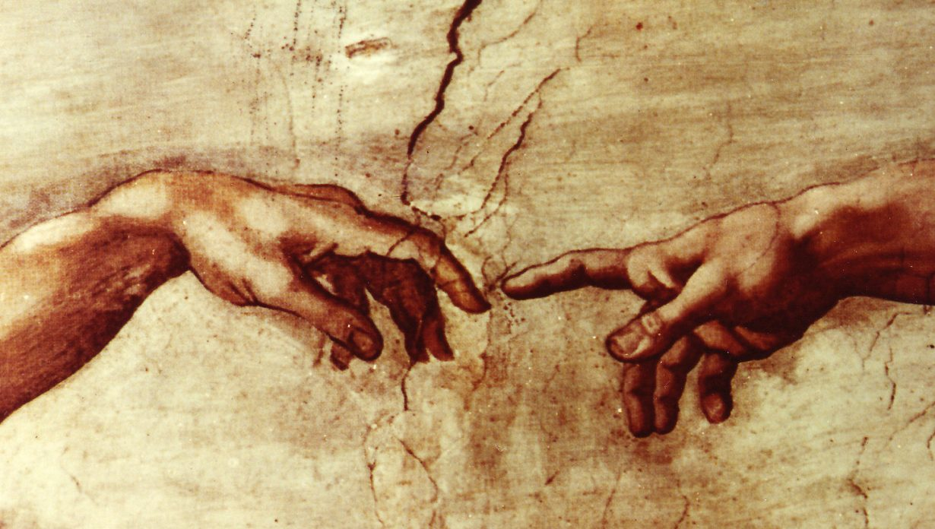
“In his nature, person and personality, in his moral and spiritual capacities, in his emotions, intellect, conscience and will, man stands apart from the brute creation.” John Phillips

Slide 21
DAY #7 – GOD’S REST
GENESIS 2:1-3
1 Thus the heavens and the earth were completed in all their vast array.
2 By the seventh day God had finished the work he had been doing; so on the seventh day he rested from all his work. 3 Then God blessed the seventh day and made it holy, because on it he rested from all the work of creating that he had done.
Matthew 11:28 “Come to me, all you who are weary and burdened, and I will give you rest.“

Slide 22
Psalm 8:
1 O Lord, our Lord, how majestic is Your name in all the earth!
You have set your glory above the heavens.
2 From the lips of children and infants You have ordained praise because of Your enemies, to silence the foe and the avenger.
3 When I consider Your heavens, the work of Your fingers, the moon and the stars, which You have set in place,
4 what is man that You are mindful of him, the son of man that You care for him?

Slide 23
Psalm 8:
5 You have made him a little lower than the heavenly beings and crowned him with glory and honour.
6 You made him ruler over the works of Your hands; you put everything under his feet:
7 all flocks and herds, and the beasts of the field,
8 the birds in the air, and the fish of the sea, all that swim the paths of the seas.
9 O Lord, our Lord, how majestic is Your name in all the earth!
(AMEN!)

Slide 24
Useful Websites:
Creation Ministries International (Creation.com)
Answers in Genesis (AnswersInGenesis.org)
The Institute for Creation Research (icr.org)

